Slide 1
Summary of Steering Committee Meeting
PRAGMA 22
19 April 2012

Slide 2
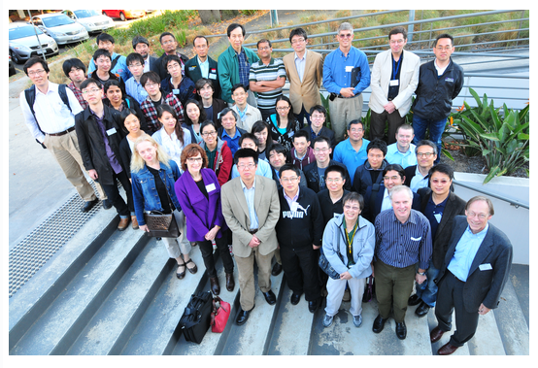
PRAGMA 22

Slide 3
Applications and New Members Relevance to Structure
Engaging Applications
Persistent and Transitory
Working Groups
Stable, but perhaps less flexible for new activities
Alternatives: Task Groups
Minimum set of principles to get started (e.g. different institutions)
Membership
“Heavy process”
Is there another intermediate step
What is the value proposition
Opportunity to talk after workshop

Slide 4


Future Meetings
PRAGMA 23
Hosted by Konkuk University
Between Mid-September and Mid-October, 2012
Seoul, Korea
PRAGMA 24
Hosted by Kasetsart University
Third week of March (18 – 22), 2013
Bangkok, Thailand

Slide 5
Engaging Researchers Hong Kong and Southern China
Tremendous growth in investments in southern China,
Genomics
Computing
Tremendous opportunities for PRAGMA and networking

Slide 6
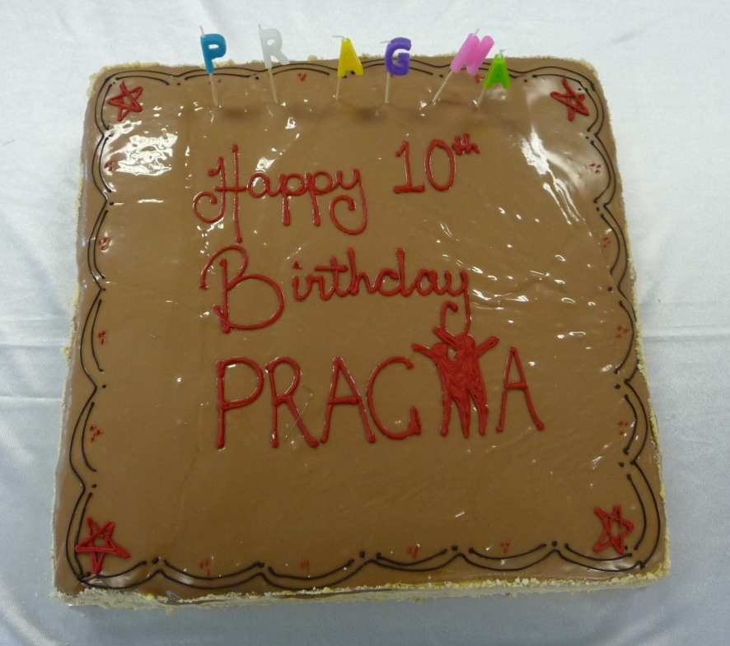
Thank You
Chao Jin
Michelle Ketchen
Christina Branton
Paul Bonnington
Philip Chan
Maria Indrawan
David Abramson
Reed Beaman (University of Florida)
Blair Bethwaite (Monash University)
Kevin Dong (Computer Network Information Center, Chinese Academy of Science)
Weicheng Huang (National Center for High-Performance Computing)
Kohei Ichikawa (Osaka University)
Chao Jin (Monash University)
Kwan Wing Keung (HongKong University)
Mohd Azam Osman (Universiti Sains Malaysia)
Jeff Tan (Monash University)
Sameer Tilak (Calit2/UCSD)
Putchong Uthayopas (Kasetsat University)
Sornthep Vannarat (National Electronics and Computer Technology Center)
Yang Zhang (Lanzhou University)
Cindy Zheng (San Diego Supercomputer Center)

Slide 7
And More
Students – Please stay for 30 minutes
Dinner – Zagames – 6 pm?
Who wants to come?

